Slide 1

DEVELOPMENT OF A FACE RECOGNITION SYSTEM WITH ATTENDANCE RECORD
GRADUATION PROJECT
AHMED ASFOUR
204410810
SUPERVISOR : DOÇ.DR. KEMAL AKYOL

Slide 2
OUTLINE
About Face Recognition
Project Details
Tools
Implementation
Steps of Face Recognition
Feature Matching
Face Detectiom
Feature Extraction
Face Alignment
Normalization
Methods

Slide 3
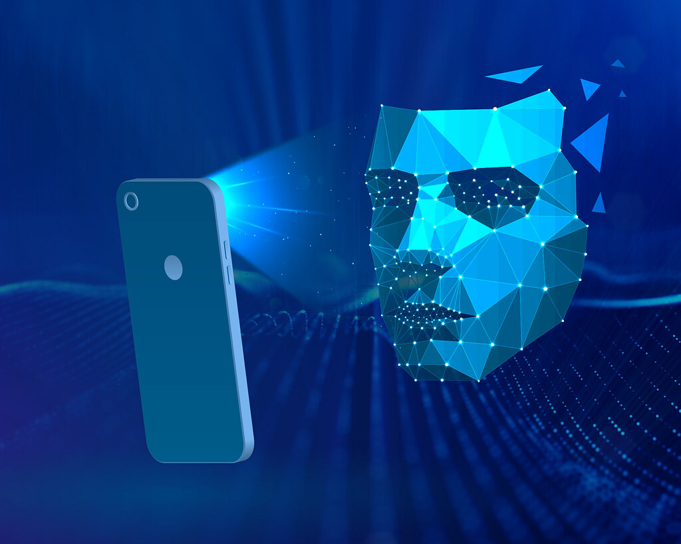
ABOUT FACE RECOGNITION
A method of identifying or verifying the identity of a person using his/her face.

Slide 4
STEPS OF FACE RECOGNITION
FACE DETECTION
FACE ALIGNMENT
NORMALIZATION
FEATURE EXTRACTION
FEATURE MATCHING

Slide 5

STEPS OF FACE RECOGNITION / FACE DETECTION
The first step in face recognition algorithms is detecting the face.

Slide 6
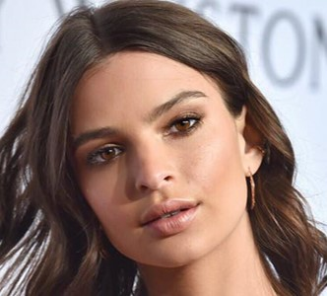
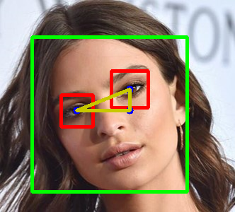
STEPS OF FACE RECOGNITION / FACE ALIGNMENT
After having face in the image/video detected, the face must be aligned.

Slide 7
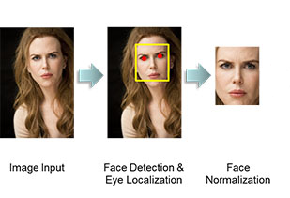
STEPS OF FACE RECOGNITION / NORMALIZATION
Here in face recognition, the images must be appropriate to recognize the face.

Slide 8
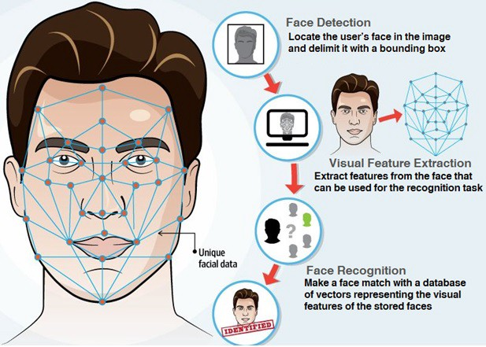
STEPS OF FACE RECOGNITION / FEATURE EXTRACTION
It is a process of converting the landmarks into numbers in short.

Slide 9

STEPS OF FACE RECOGNITION / FEATURE MATCHING
It’s literally making a classification process at the end and it gives the result with an accuracy.

Slide 10

PROJECT DETAILS / OpenCV
OpenCV (Open Source Computer Vision Library)
is an open source computer vision
and machine learning software library.
The library has more than 2500 optimized algorithms used for:
Recognize faces
Identify objects
Image matching
Track camera movements
Track moving objects
Tracking eyes movements
Recognize scenery

Slide 11

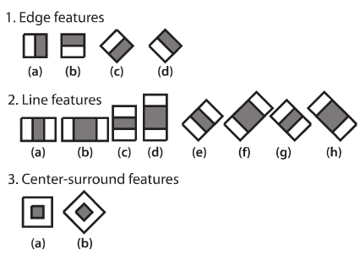
PROJECT DETAILS / Face dedetion
Face detection and Haar Cascade Classifiers
OpenCV's algorithm is currently using the following Haar-like features which are the input to the basic classifiers:

Slide 12
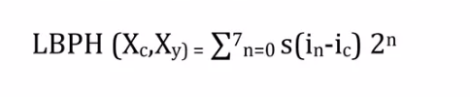
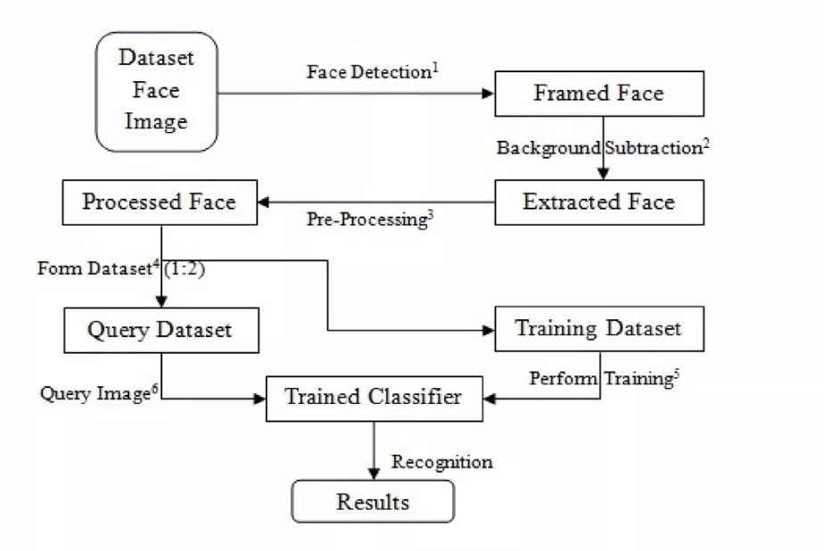
PROJECT DETAILS / LBPH METHODS

Slide 13
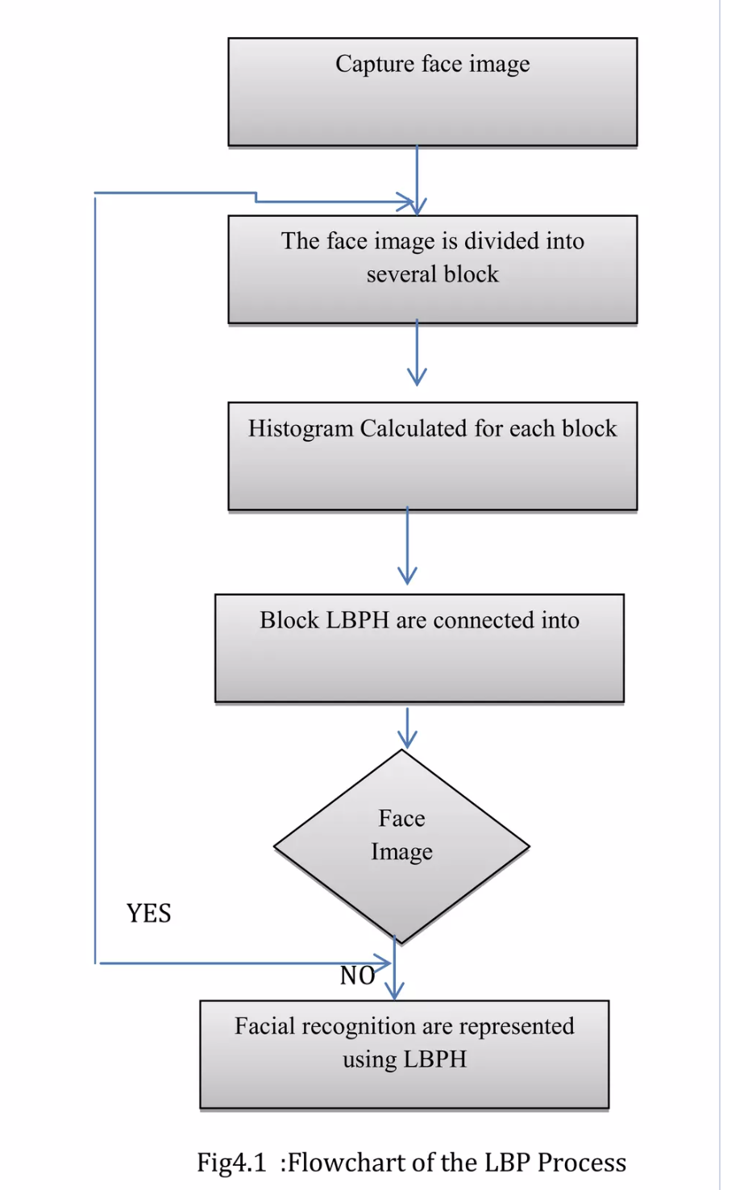
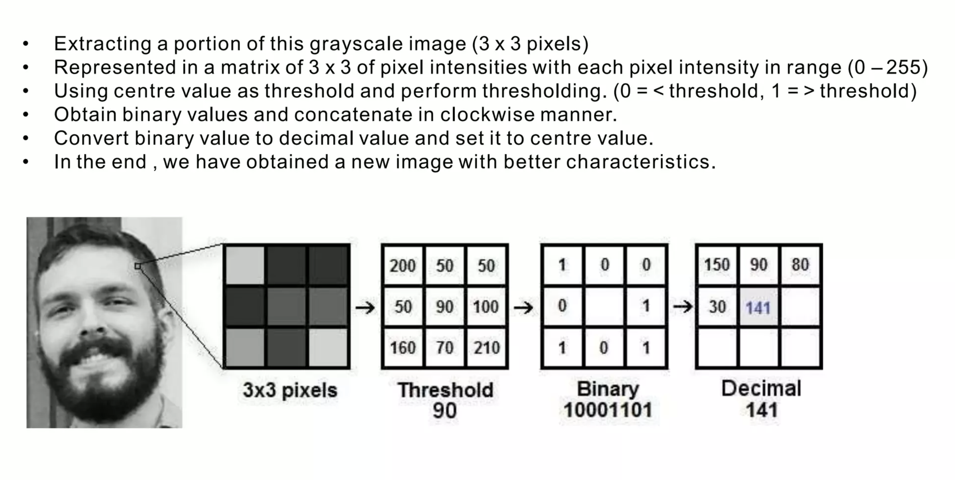
PROJECT DETAILS / METHODS
LBP combined with Histogram to predict faces:

Slide 14
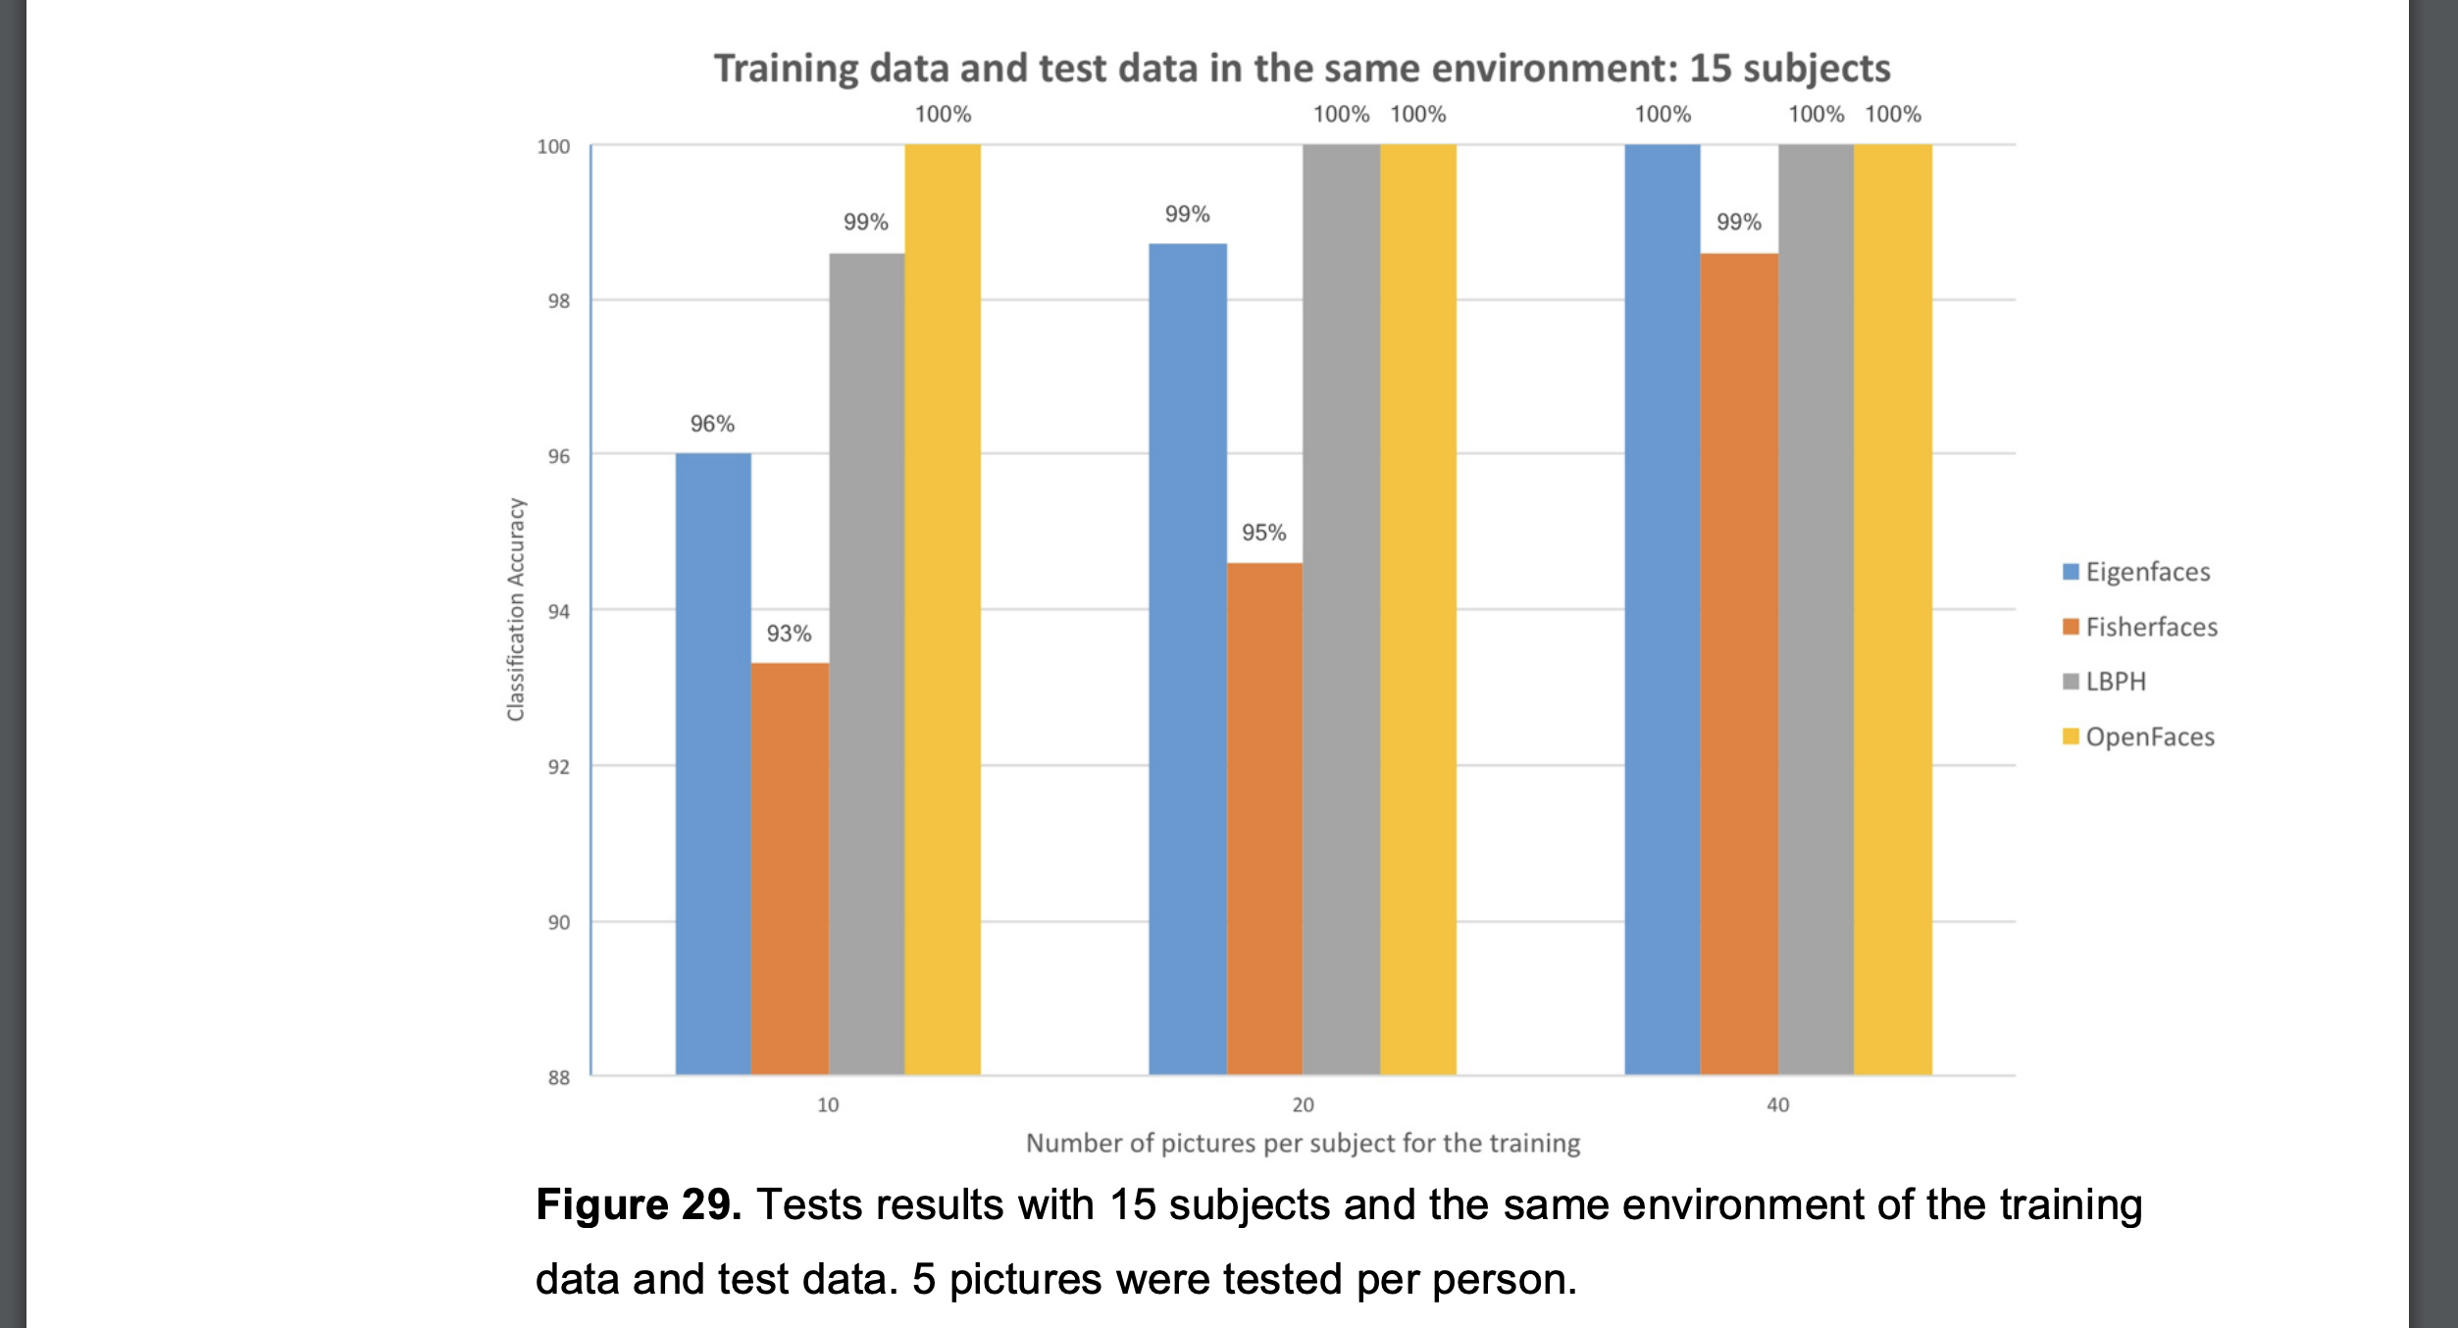
PROJECT DETAILS / METHODS
Local Binary Patterns Histograms

Slide 15
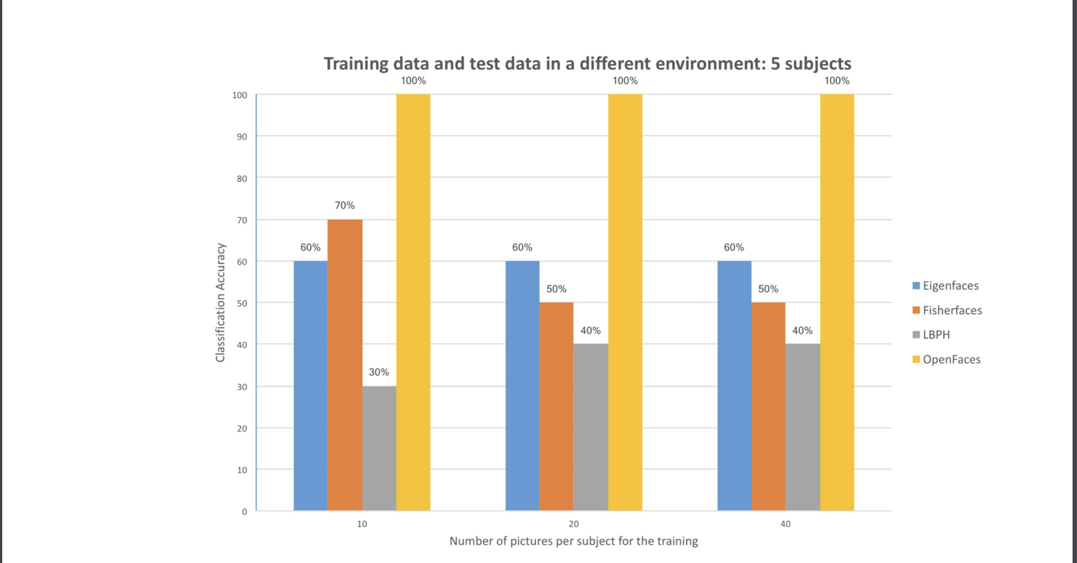
PROJECT DETAILS / METHODS

Slide 16
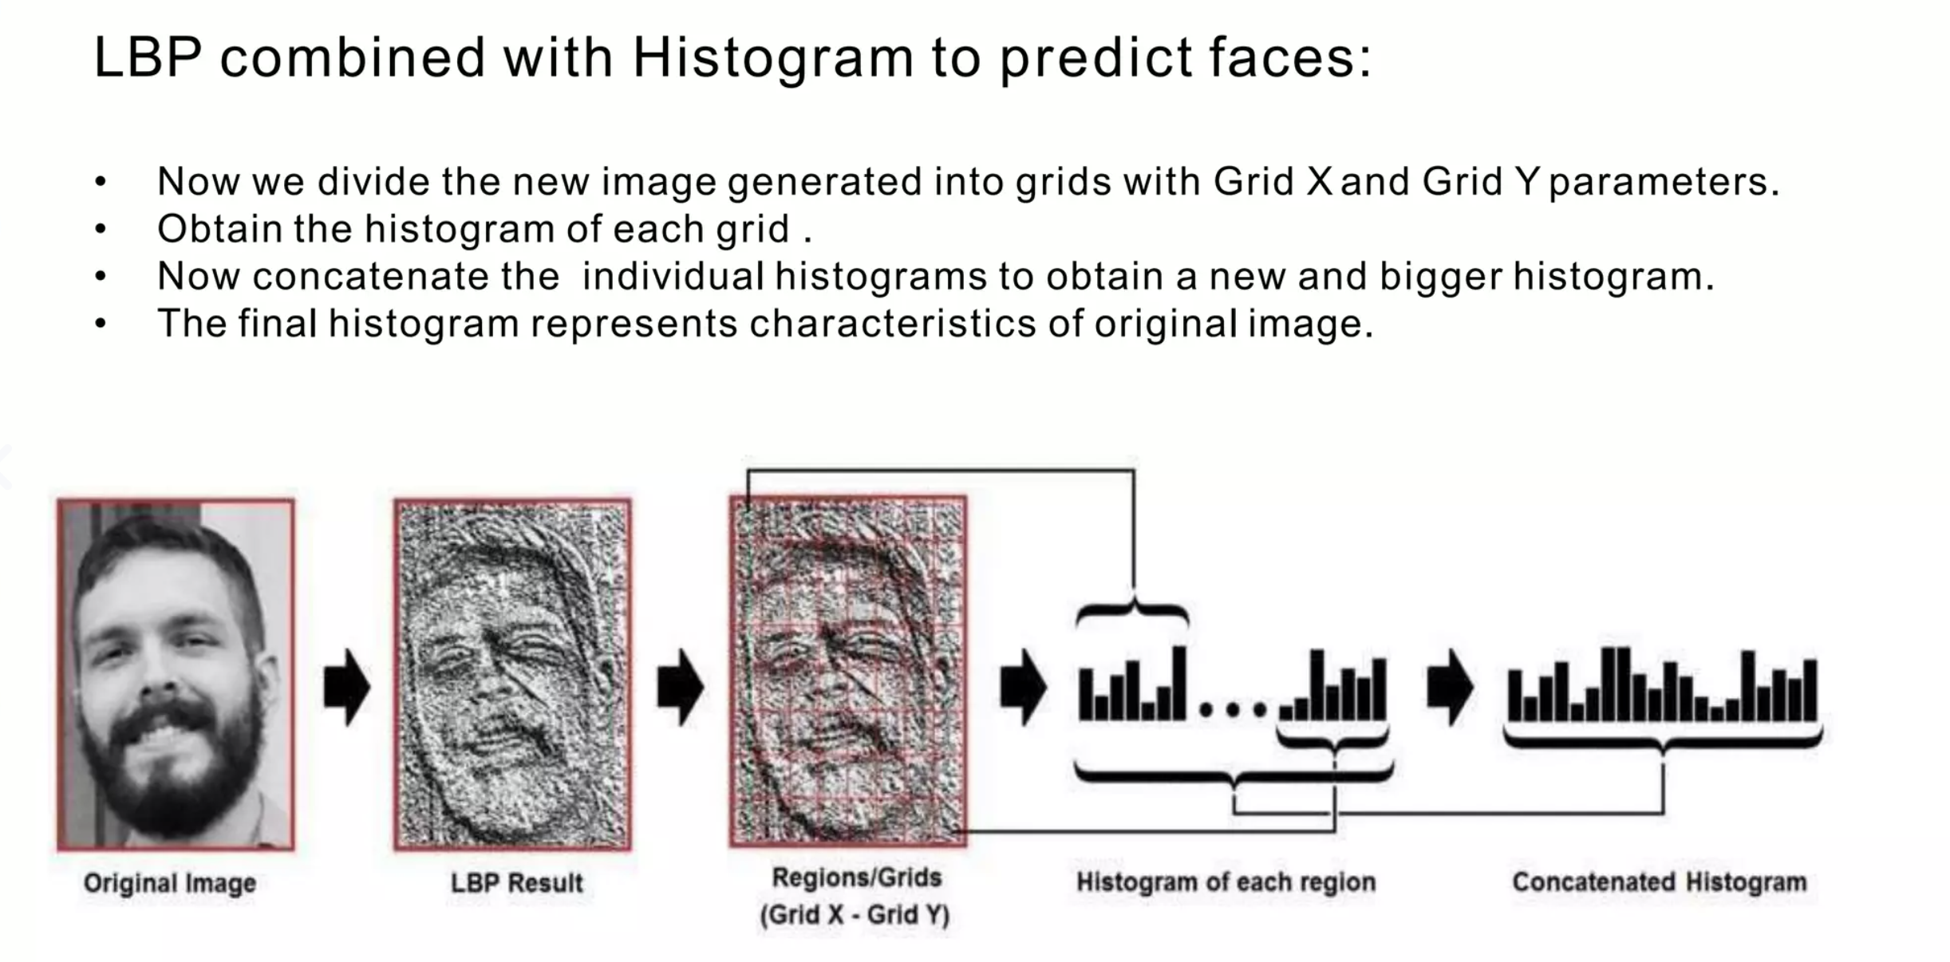
PROJECT DETAILS / METHODS

Slide 17
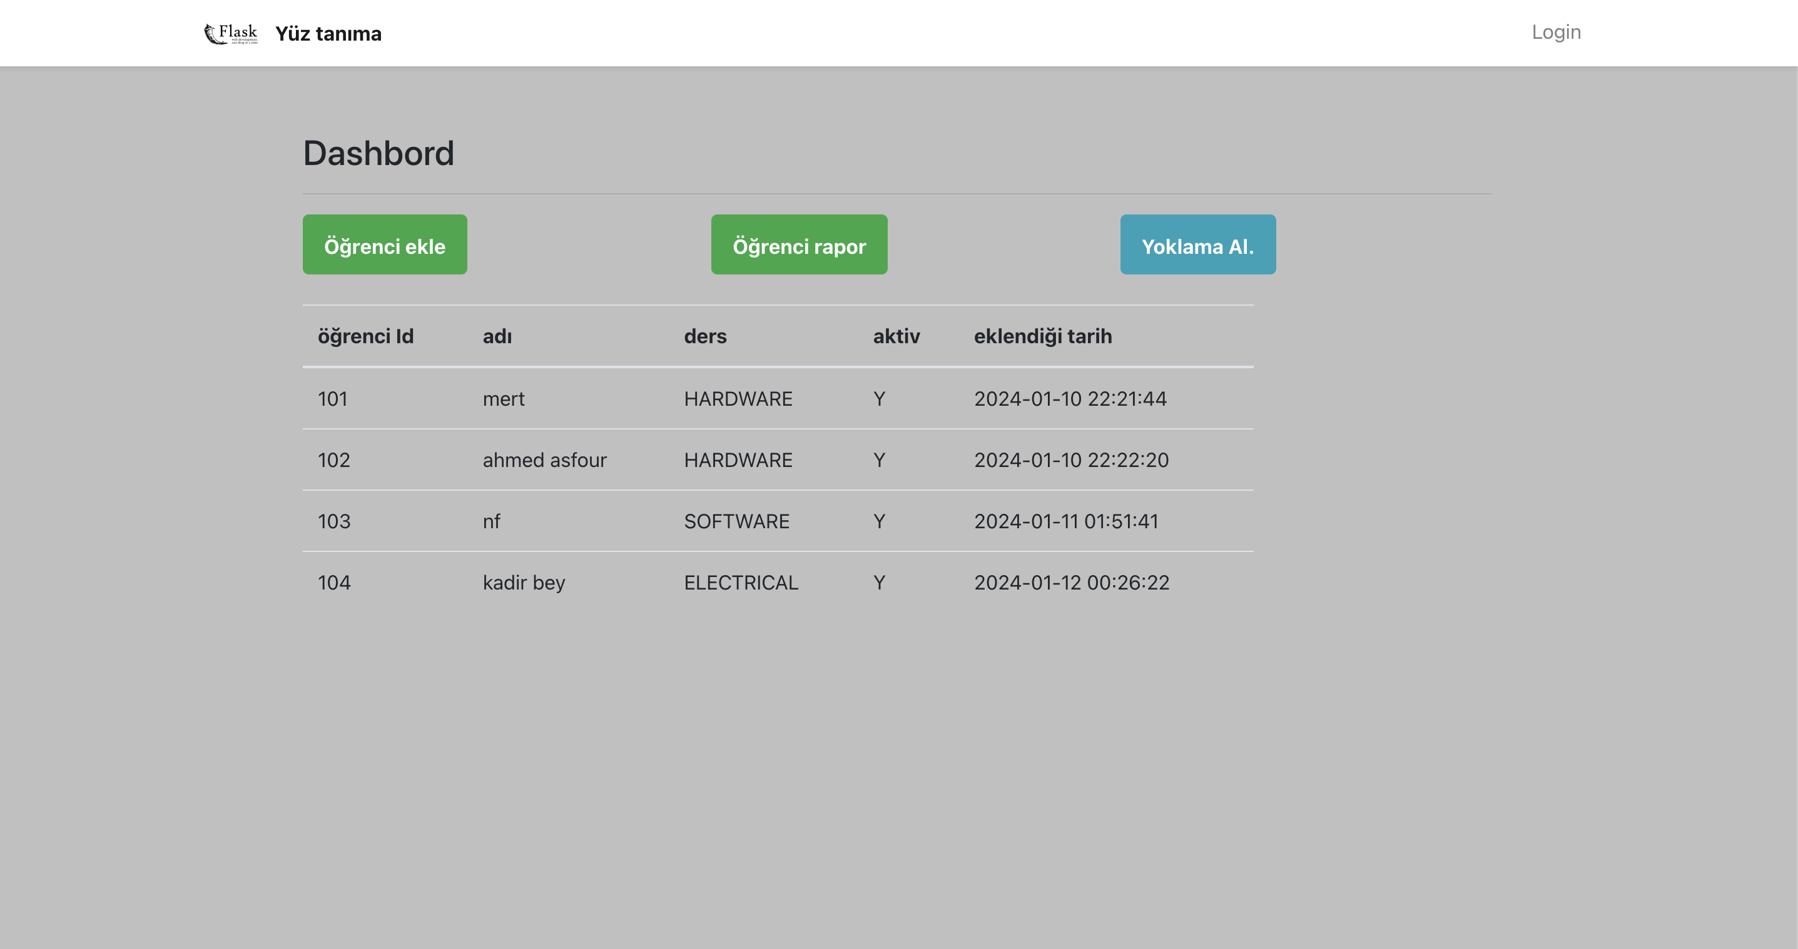
PROJECT DETAILS / IMPLEMENTATION
dashbord Screen of the Application

Slide 18
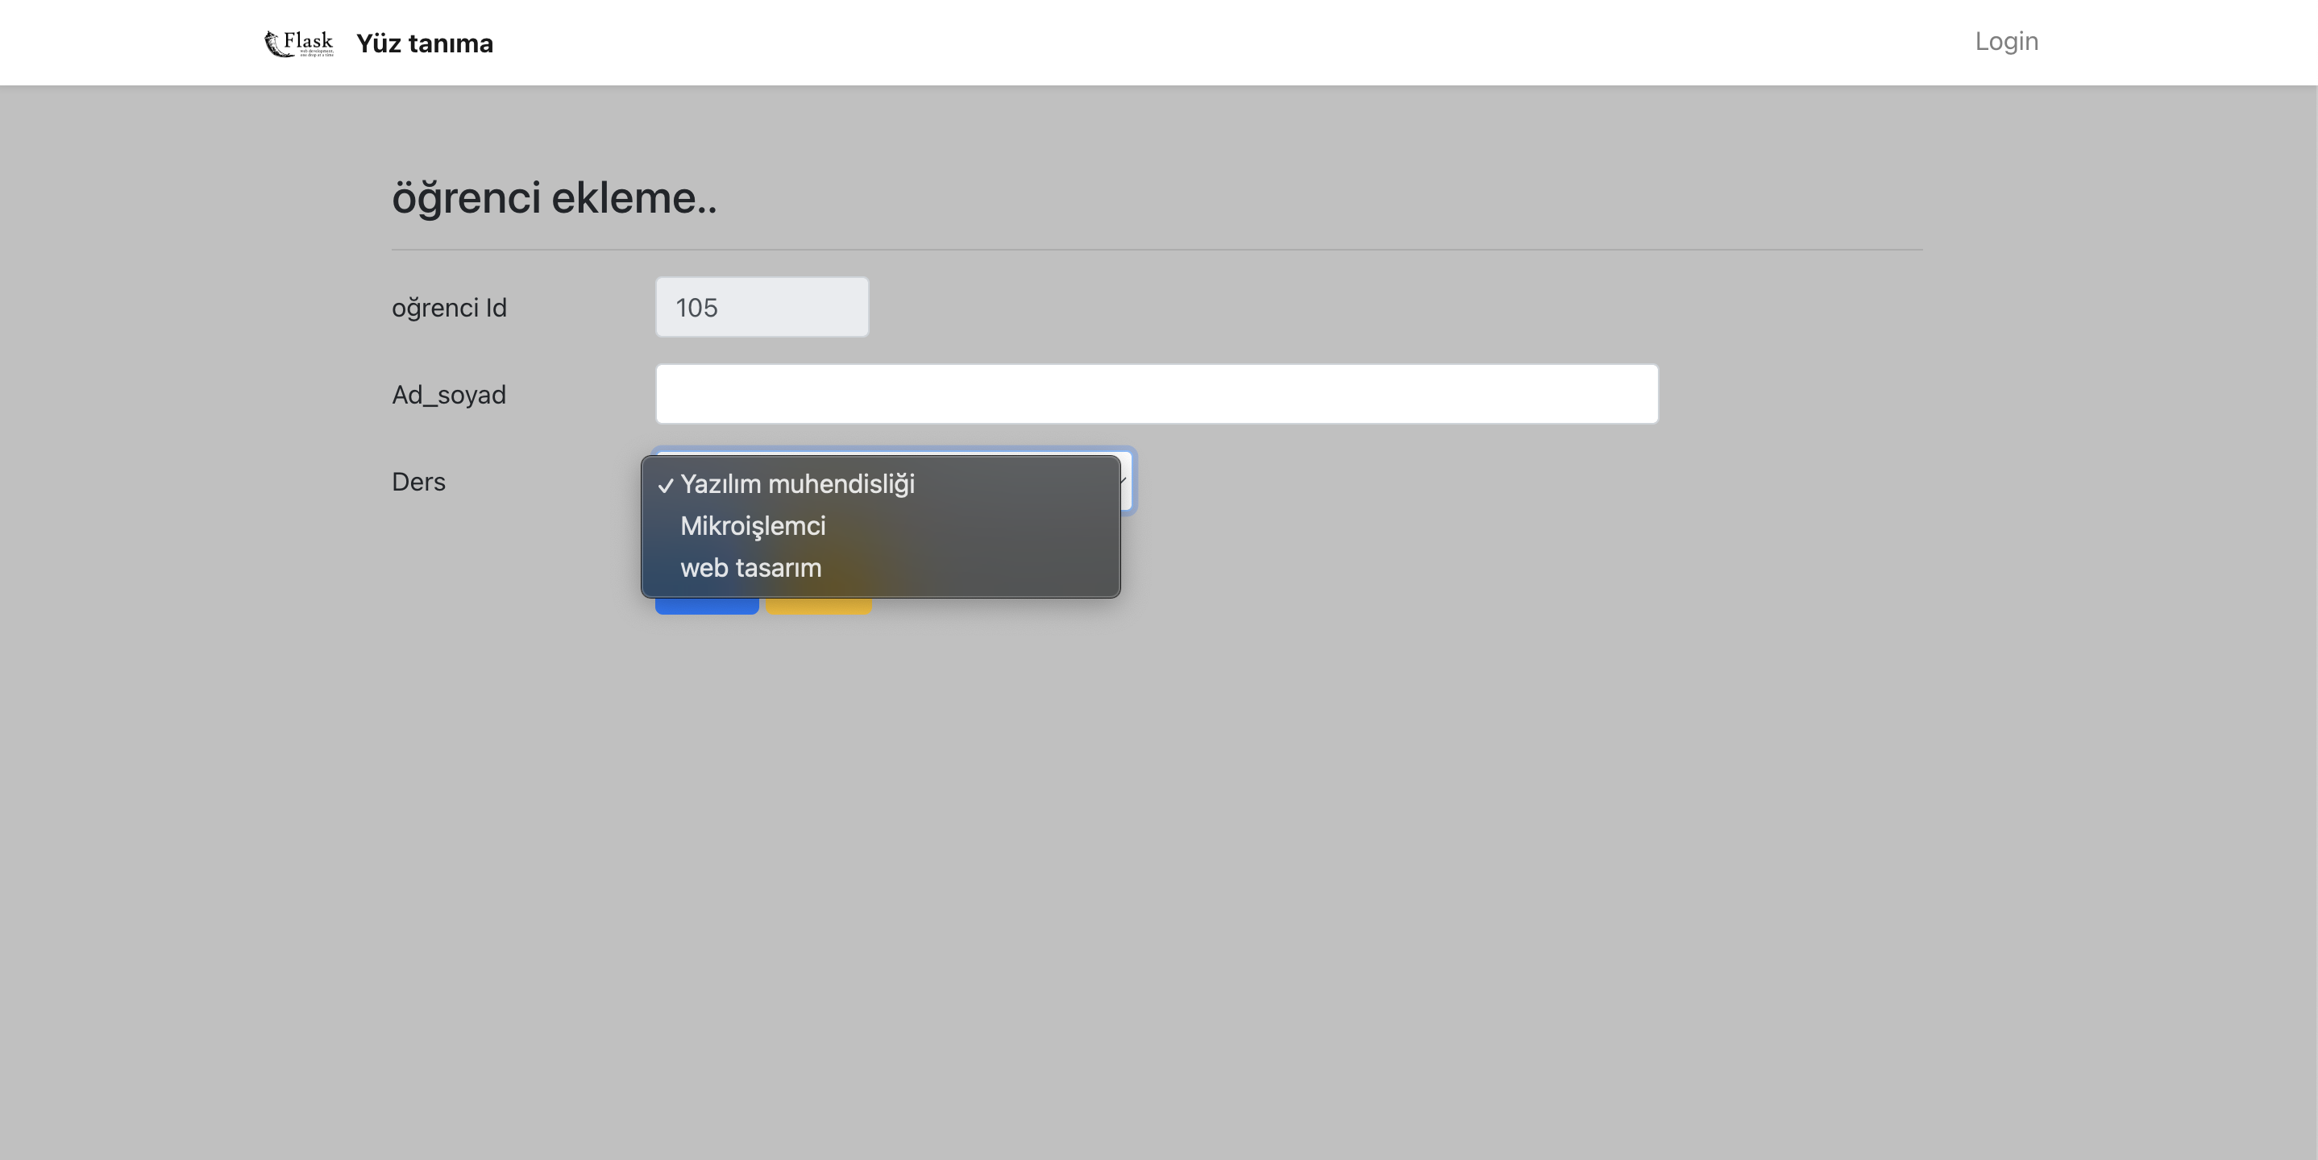
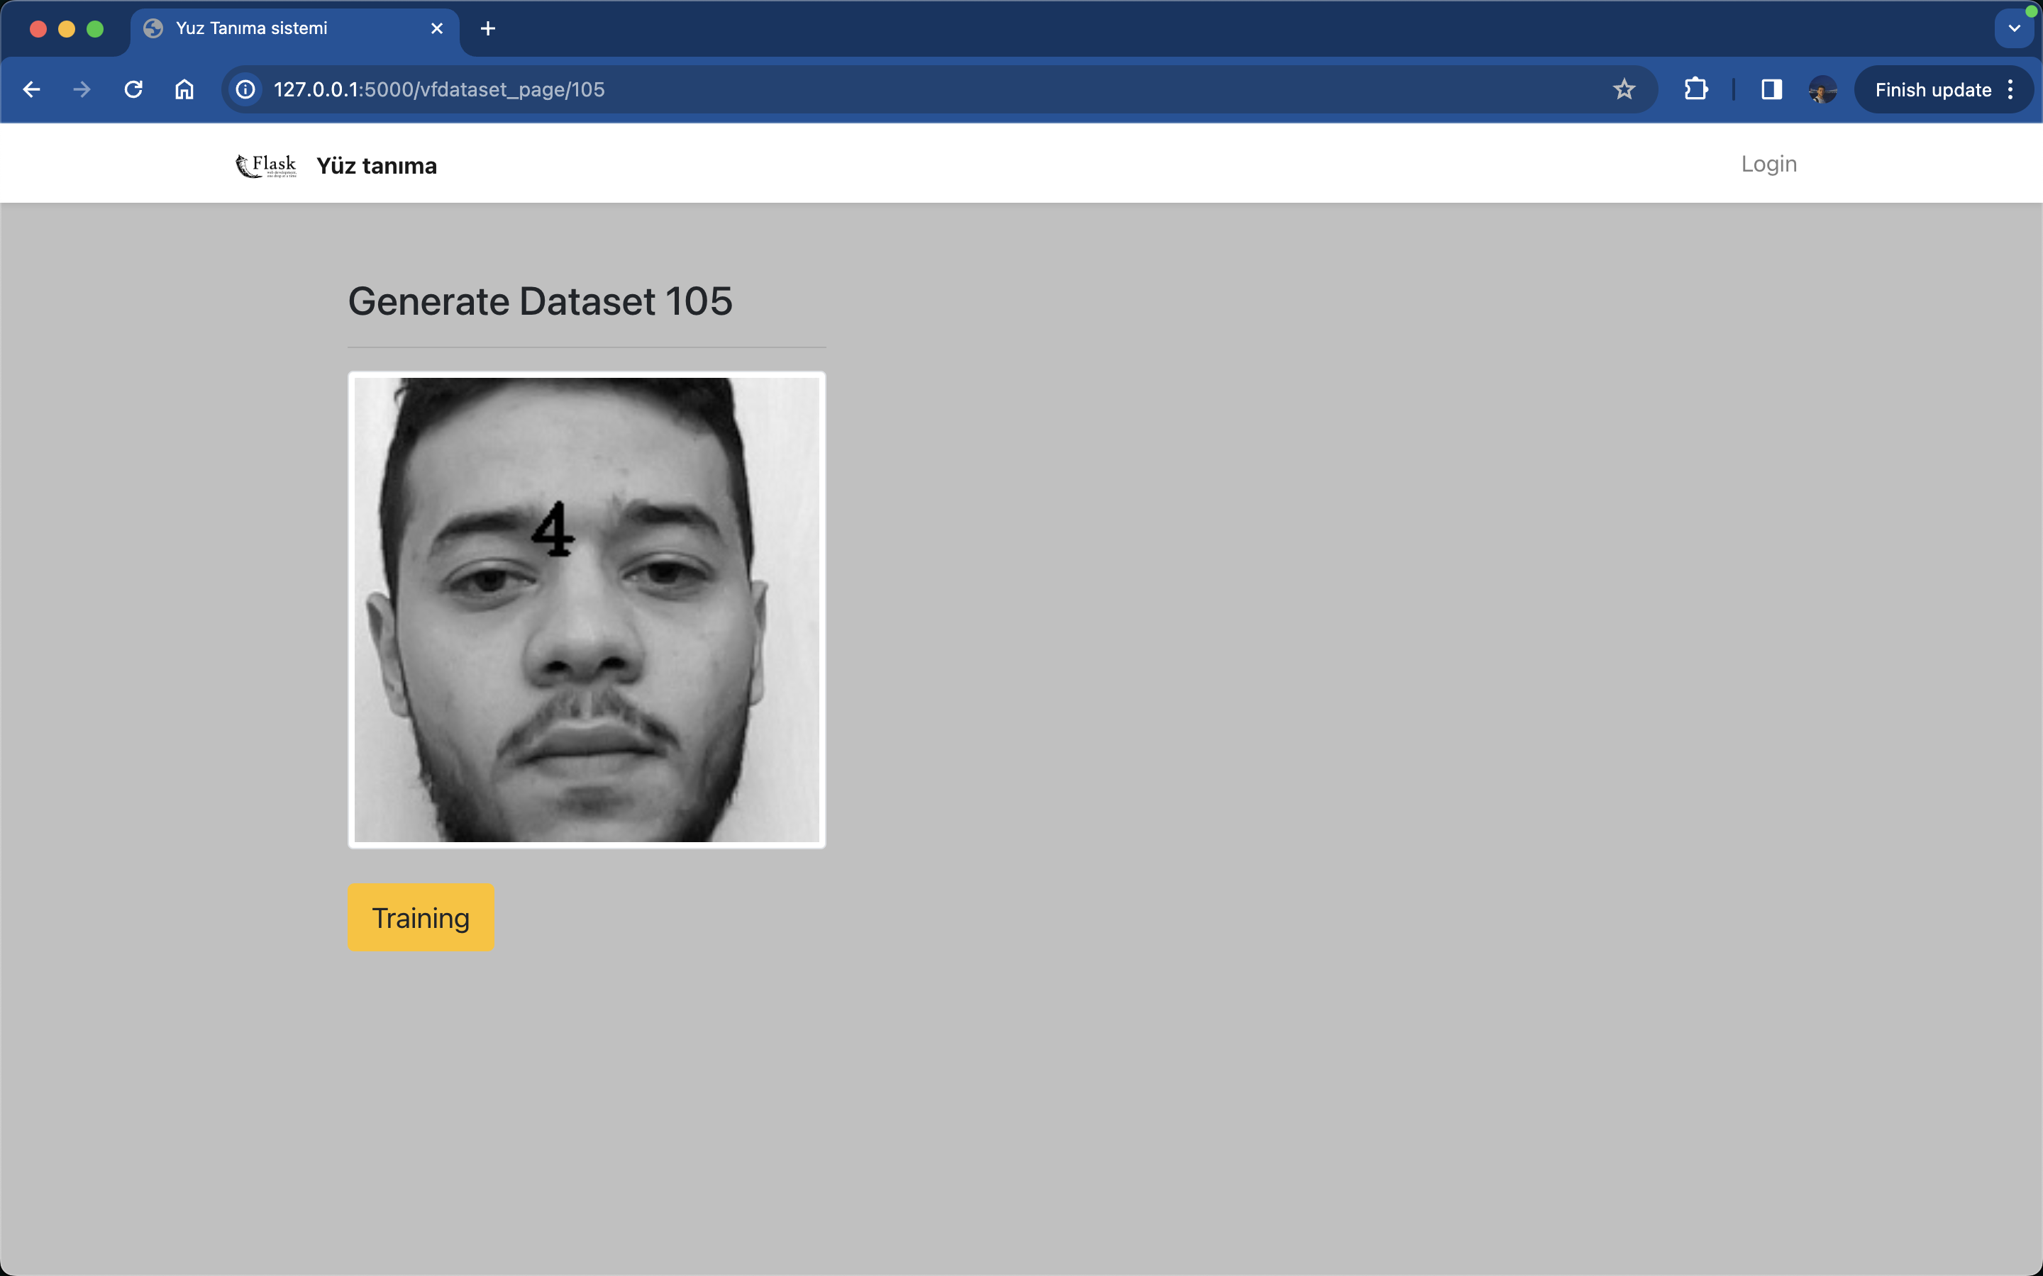
PROJECT DETAILS / IMPLEMENTATION
Register in the attendance system

Slide 19
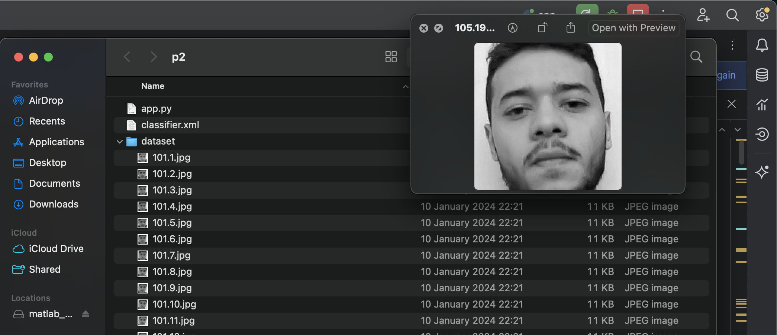
PROJECT DETAILS / IMPLEMENTATION
Creating the Dataset

Slide 20
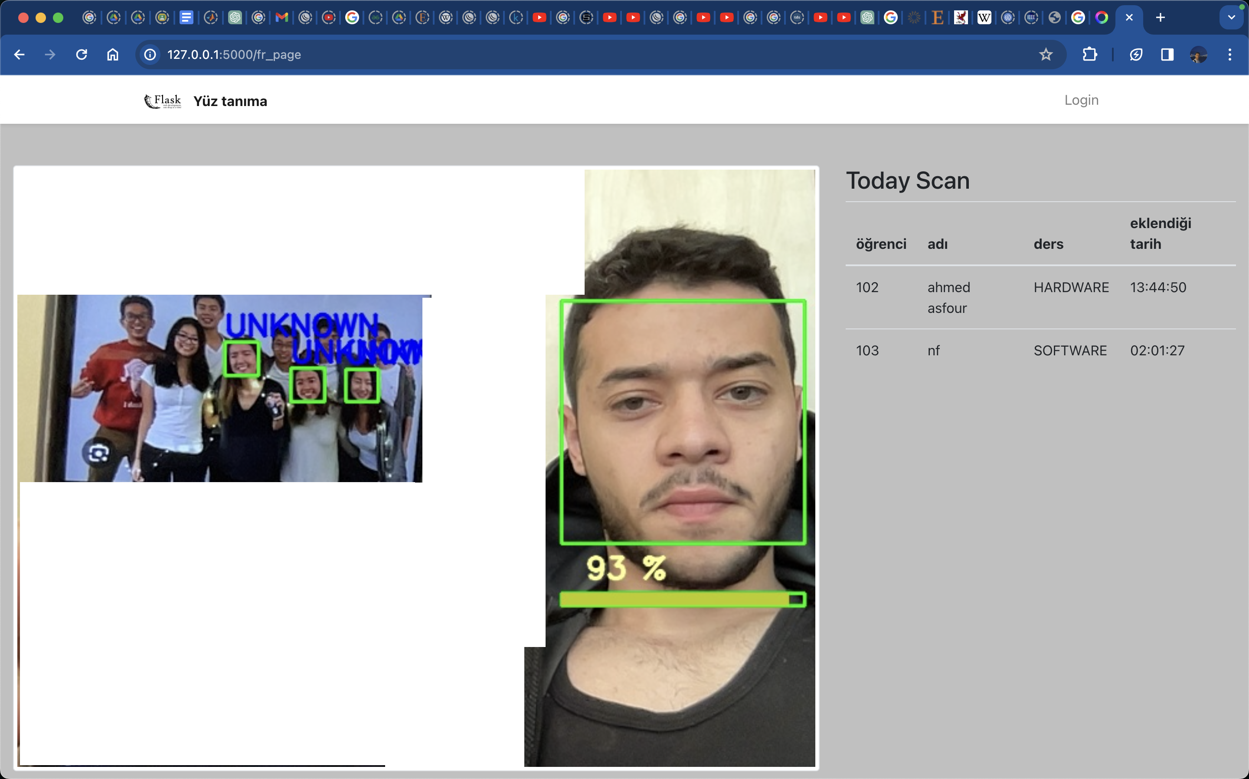
PROJECT DETAILS / IMPLEMENTATION
Attendance taking page

Slide 21
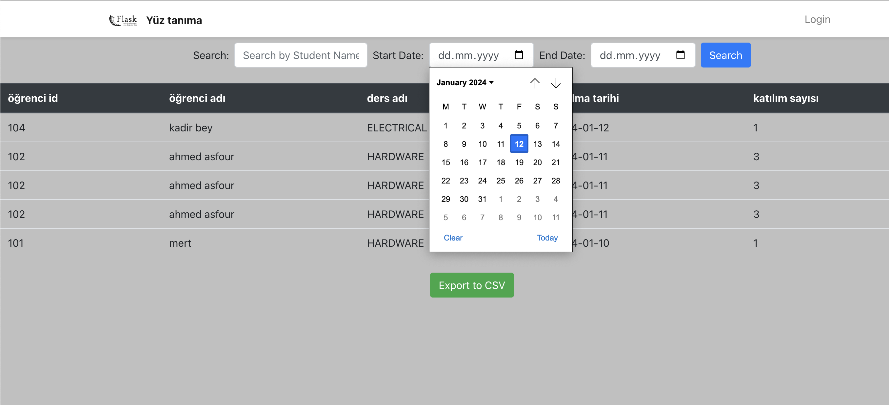
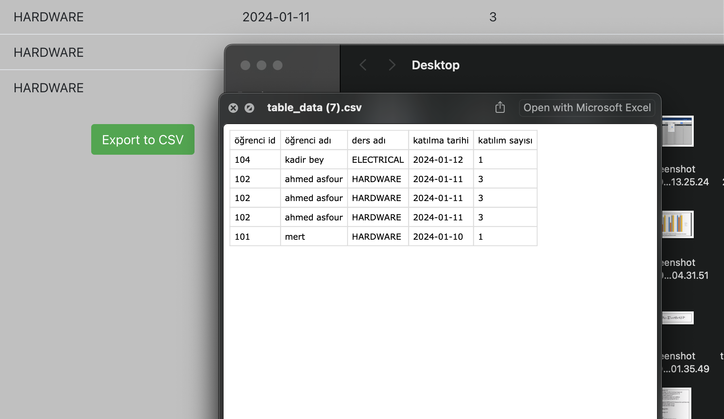
PROJECT DETAILS / IMPLEMENTATION
Raport & Filling the Attendance List

Slide 22


